Slide 1
TFA : A Tunable Finite Automaton for Regular Expression Matching
Author:
Yang Xu, Junchen Jiang, Rihua Wei, Tang Song and H. Jonathan Chao
Publisher:
Technical Report
Presenter:
Ye-Zhi Chen
Date:
2013/04/17

Slide 2
Introduction
The main contributions in this paper :
We introduce TFA, the first finite automaton model with a clear and tunable bound on the number of concurrent active states (more than one) independent of the number and patterns of regular expressions.
A mathematical model is built to analyze the set split problem (SSP)
We develop a novel state encoding scheme to facilitate the implementation of a TFA.
The proposed TFA is evaluated using regular expression sets from Snort and Bro.

Slide 3
Introduction
This paper proposed a new finite automaton TFA, the first finite automaton model with a clear and tunable bound on the number of concurrent active states (more than one) independent of the number and patterns of regular expressions.

Slide 4
Motivation
Patterns :
.*a.*b[ˆa]*c
.*d.*e[ˆd]*f
.*g.*h[ˆg]*i
Alphaset Σ ={a, b, ..., i}
Number of state in DFA :54
Number of state in NFA :10
the NFA requires much less memory, its memory bandwidth requirement is four times that of the DFA

Slide 5
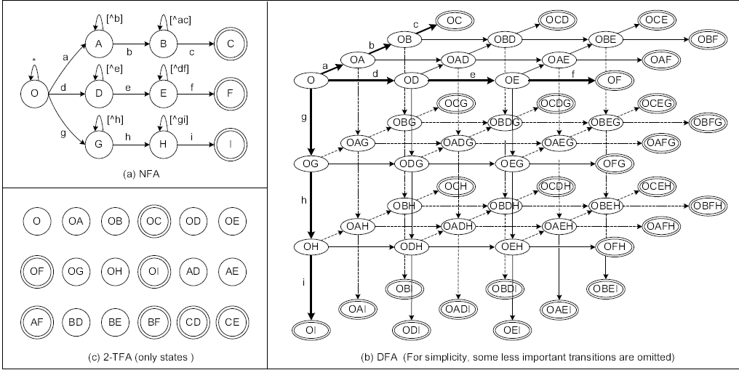
Motivation

Slide 6
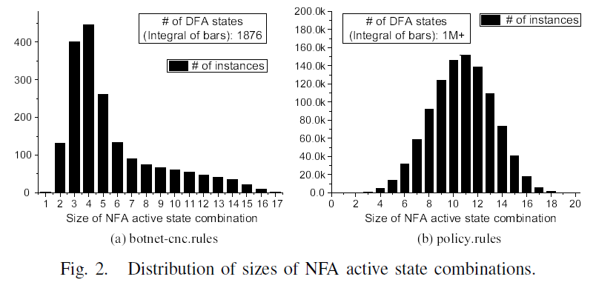
Motivation

Slide 7

Motivation
We have seen the main reason for the DFA having far more states than the corresponding NFA is that the DFA needs one state for each NFA active state combination
One possible solution is to allow multiple automaton states (bounded by a given bound factor b) to represent each combination of NFA active states. We name it Tunable Finite Automaton (TFA).
N_{T} : the number of TFA states
P : the number of all possible statuses that can be represented by at most b active states
A TFA with N_{T} = O (log_{b} (N_{D}) ) states can represent a DFA with N_{D} states

Slide 8
TUNABLE FINITE AUTOMMATON(TFA)
Definition :
A b-TFA is a 6-tuple < Q_{T} , Σ, δ_{T} , I, F_{T} , SS >
A finite set of TFA states Q_{T} ;
A finite set of input symbols Σ;
A transition function δ_{T} : Q_{T} × Σ→ P(Q_{N});
A set of initial states I ⊆ Q_{T} , |I| ≤ b;
A set of accept states F_{T} ⊆ Q_{T} ;
A set split function SS : Q_{D} → (Q_{T} )^{b} ∪. . .∪(Q_{T} )¹.

Slide 9
Constructing A TFA
The implementation of a TFA logically consists of two components :
A TFA structure
Set Split Table (SST) : Each entry of the SST table corresponds to one combination of NFA active states (i.e., a DFA state) recording how to split the combination into multiple TFA states

Slide 10
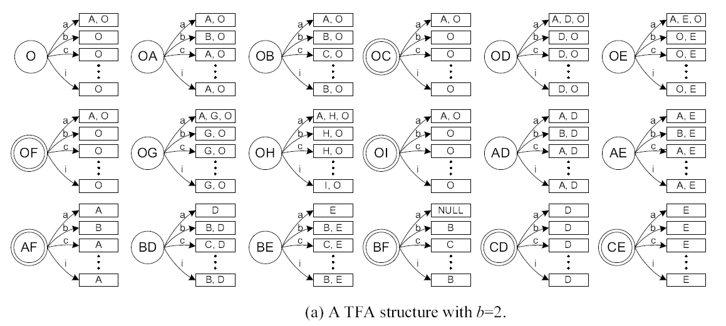
TFA

Slide 11
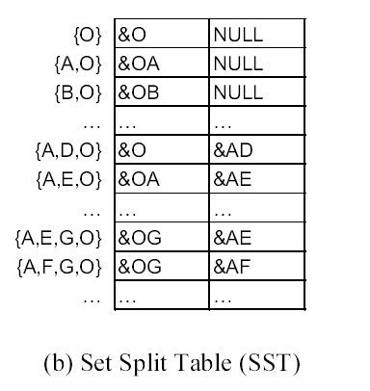
Constructing A TFA

Slide 12
Constructing A TFA
Generating a equivalent b-TFA from an NFA consists of four steps:
Generate the DFA states using the subset construction scheme
Split each NFA active state combination into up to b subsets. After this step, we obtain the TFA state set Q_{T} and the set split function SS;
Decide the transition function δ_{T} . Outgoing transitions of TFA states point to a data structure called state label, which contains a set of NFA state IDs.
Decide the set of initial states (I) and the set of accept states (F_{T} )

Slide 13
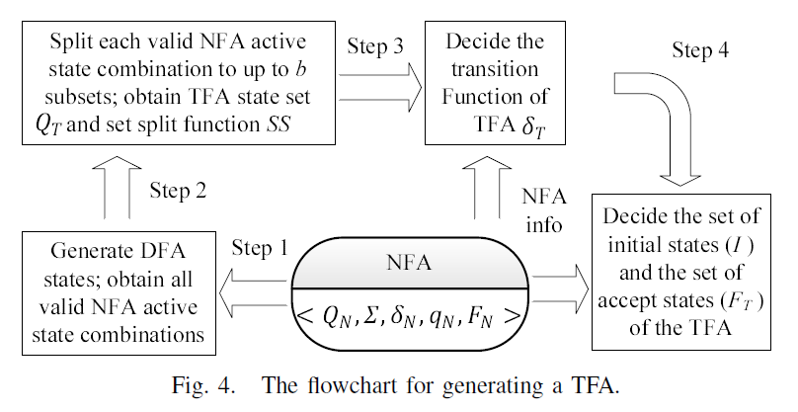
Constructing A TFA

Slide 14
Operating A TFA
assume the input string is “adegf ”.
Initial active state : O
a : return label {A,O}, next active states : OA
d : return label {A,D,O}, next active states :O , AD
e : return label {A,E,O}, next active states :O , AE
g : return label {A,E,G,O}, next active states :OG , AE
f : return label {A ,F,G,O}, next active states :OG , AF
AF is an accept state => match!

Slide 15
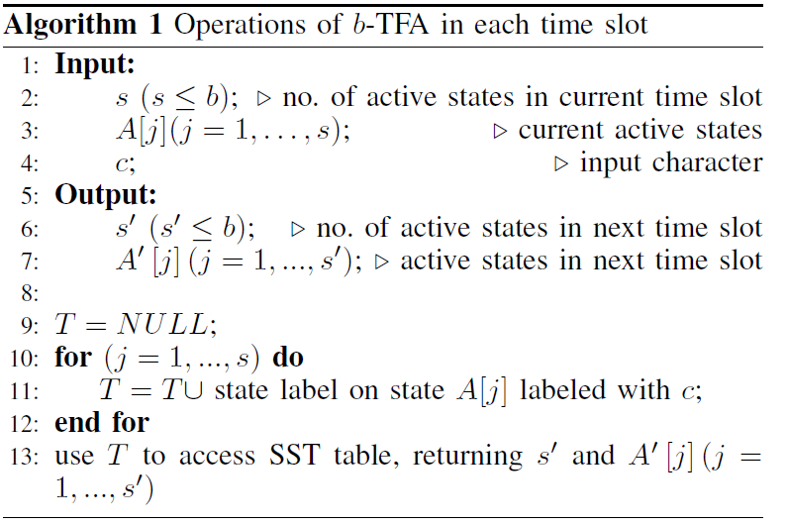
Operating A TFA

Slide 16
Splitting NFA Active State Combinations
Set Split Problem (SSP) :
Find a minimal number of subsets from the NFA state set, so that for any valid NFA active state combination, we can always find up to b subsets to exactly cover it
b-SSP problem is an NP-hard problem for any b > 1

Slide 17
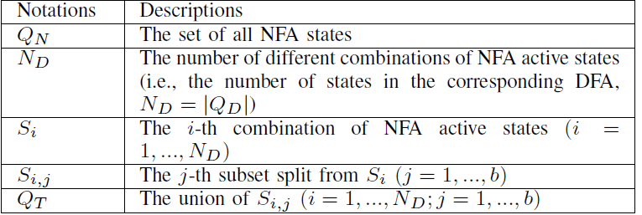
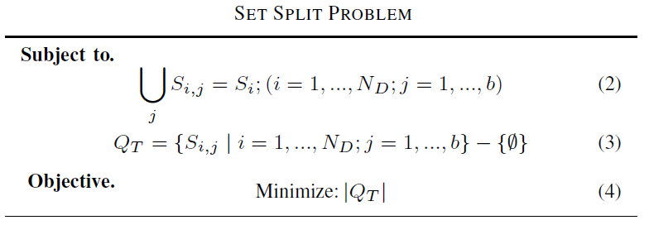
Splitting NFA Active State Combinations

Slide 18
Splitting NFA Active State Combinations
A Heuristic Algorithm for SSP Problem
To simplify the problem, we add another constraint on the model of the b-SSP problem :

Slide 19
State Encoding
Original : using an array to store state labels which include different numbers of NFA state IDs
Problem :
  High storage cost
  TDA operation overhead :
    Redundancy elimination
    Sorting
Solution : bit vector

Slide 20
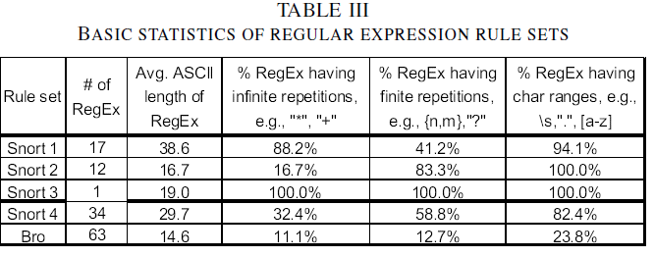
Performance Evaluation

Slide 21
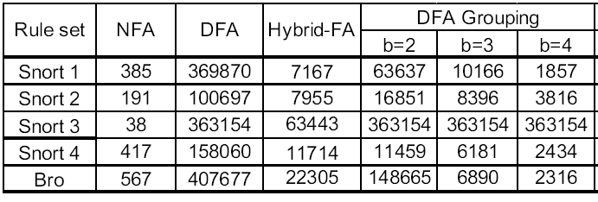
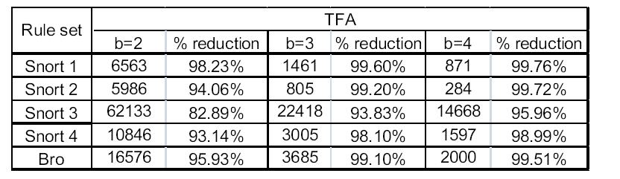
Performance Evaluation

Slide 22
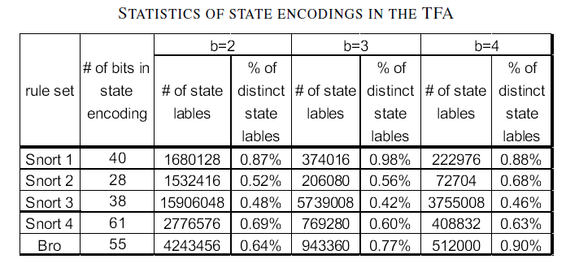
Performance Evaluation

Slide 23
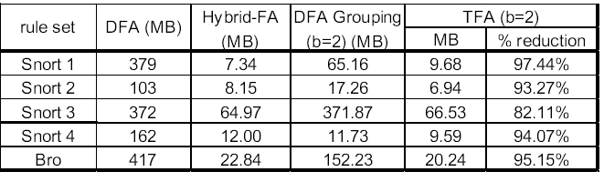
Performance Evaluation

Slide 24
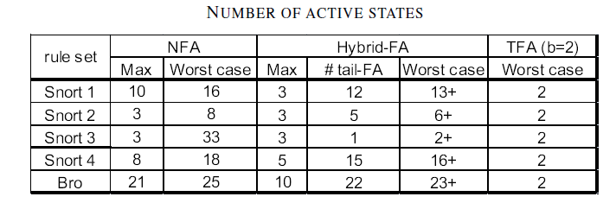
Performance Evaluation

