Slide 1
PCAPLib: A System of Extracting, Classifying, and Anonymizing Real Packet Traces
Author:Ying-Dar Lin, Po-Ching Lin
Publisher:IEEE SYSTEMS JOURNAL2016

Slide 2
In this paper, designed the PCAPLib system to automatically extract, classify, and anonymize packet traces from a large amount of real network trafﬁc. The packet traces will be useful for various purposes of network analysis.
PCAPLib has two parts
Active trace collection (ATC)
PCAPAnon

Slide 3
The ATC mechanism can automatically classify and extract application sessions from bulk network trafﬁc in a real environment and it is essential to continuously maintain the repository of packet traces in a scalable manner.

Slide 4
A ready-to-use implementation of the PCAPAnon mechanism can anonymize sensitive information in the packet traces for hundreds of application protocols as much as possible in current practices while preserving both the semantics and length of important application ﬁelds to keep the utility for later analysis.

Slide 8
The ATC involves two phases.
In the extraction phase, the ATC extracts the sessions associated with the logs generated from the DUTs.
In the classiﬁcation phase, the ATC classiﬁes the extracted packet traces into each application category with keyword matching against the logs.

Slide 10
Packet Dissection
Decode protocal
Field Transformation
Replace field value
Pattern Substitution
Substitute pattern

Slide 12
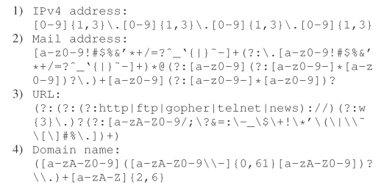

Slide 15
