Slide 1
P4-to-VHDL: Automatic Generation of 100 Gbps Packet Parsers
Authors: | Pavel Ben´aˇcek, Viktor Puˇ, Hana Kub´atov´a
Publisher: | 2016 FCCM
Presenter: | Tzu-Chieh, Lin
Date: | 107/01/03

Slide 2
INTRODUCTION
P4: Programming Protocol-independent Packet Processors makes a step forward and evades the limitation of fixed protocol set. It defines a way to configure the packet parsing functionality of switches at runtime.
It is envisioned that a P4-capable switch translates this platform-independent parser description into a representation that fits the actual hardware resources of the switch.
We contribute towards the vision of P4 by designing and evaluating a generator of high-speed packet parser suitable for FPGAs. The generator’s output is a synthetizable VHDL code that performs packet parsing as defined by the P4 program.

Slide 3
THE P4 LANGUAGE
P4: Programming Protocol-independent Packet Processors is a high-level, platform-agnostic language.
Its main purpose is to provide a way to define packet processing functionality of network devices, paying attention to reconfigurability in the field, protocol independence and target (platform) independence.
Using relatively simple syntax, P4 allows to define five basic aspects of packet processing:

Slide 4
Header Formats describe protocol headers recognized by the device.
Packet Parser describes the (conceptual) state machine used to traverse packet headers from start to end, extracting field values as it goes.
Table Specification defines how the extracted header fields are matched in possibly multiple lookup tables (e.g. exact match, prefix match, range search).
Action Specification defines compound actions that may be executed for packets.
Control Program puts all of the above together, defining the control flow mainly among the tables.

Slide 5
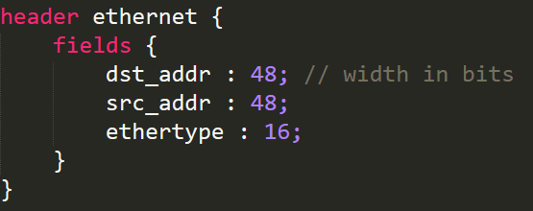
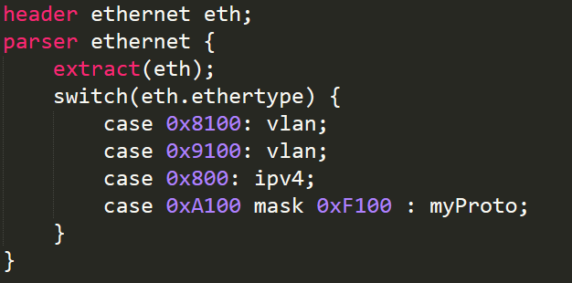
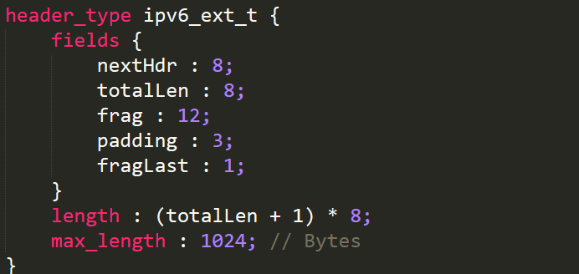

Slide 6
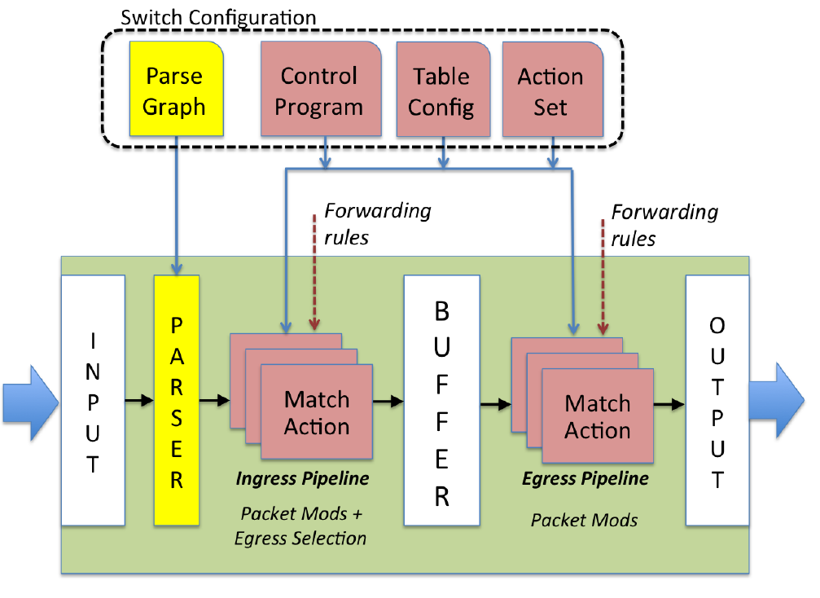

Slide 7
PARSER GENERATOR DESIGN
The main idea of automatic generation of 100 Gbps parser comes from the architecture of HFE M2. The architecture consists of two main block types - protocol analyzers and pipelines.
Protocol analyzers are the heart of the whole approach. A generic interface is used for connection between the protocol analyzers.
There is an optional pipeline block between each two protocol analyzers. The pipeline blocks can be individually enabled/disabled at compile time to tune the final frequency, latency and chip area.
Protocol analyzers and pipeline blocks are connected to the processing chain which represents the protocol stack of incoming network packet.

Slide 8
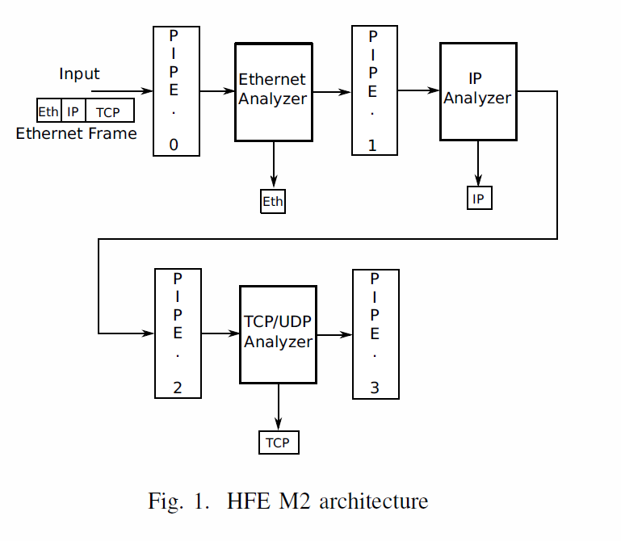
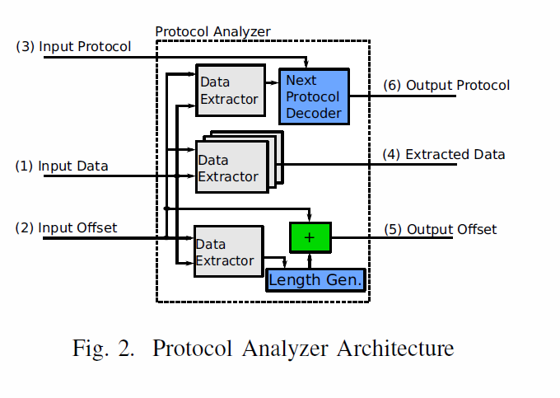

Slide 9
Protocol analyzer
Protocol analyzer uses Generic Protocol Parser Interface (GPPI) for connection between modules. This interface provides the input information necessary to parse a single protocol header.

Slide 10
That is:
(1) current packet data being transferred at the data bus.
(2) current header offset within the packet.
(3) expected protocol to parse.
GPPI output information includes
(4) extracted packet header field values, plus the information needed to parse the next protocol header
(5) next header offset
(6) type of the next protocol header.

Slide 11
Protocol Analyzer architecture contains four basic block types: (1) Data Extractors, (2) Next Protocol Decoder, (3) Length Generator and (4) Adder.
Data Extractors are used to extract packet data from a given offset. Data Extractors are configured with two parameters - Extract Length and Extract Offset.
The first parameter defines the number of extracted bytes from packet data. The offset of data within the packet is computed as the sum of current header offset (a value from GPPI interface) and the Extract Offset parameter.

Slide 12
Next Protocol Decoder is used to compute the next expected protocol. Its structure is fully dependent on the protocol header format.
Generally, it is a function converting some extracted packet header bytes into an internal number representing the protocol type.
Length Generator block is used to compute the length of current protocol header, so that it can be added to the Input Offset signal to obtain the Output Offset signal, which represents the start offset of the next protocol header.

Slide 13
Transformation from P4 to HFE M2
The transformation from P4 to HFE M2 can be divided into two basic problems (1) Generating the protocol analyzers and (2) Generating the processing chain. Inputs of the transformation process are Header Format and Parser Graph Representation.
We define the Parser Graph Representation (PGR) as an oriented graph which is generated from the P4 Packet Parser description.
Each node (or state) represents one packet header and each transition represents the next parsed protocol header. Each transition is taken based on the parsed data. Condition of a transition is inferred from the P4 Packet Parser description.

Slide 14
Loop edge represents situation when we want to support more protocols of the same type in protocol stack (like VLAN or MPLS stacking, for example).
Each non-finite state contains additional transition to the Unknown state. This state is not explicitly described in P4 program but it is implicitly required by the parser.
It represents the situation when no value matches the actual set of transition conditions (e.g. we cannot continue in the parsing of next protocol header).
The PGR representation is built from a P4 Packer Parser description using the depth-first search (DFS) algorithm.

Slide 15
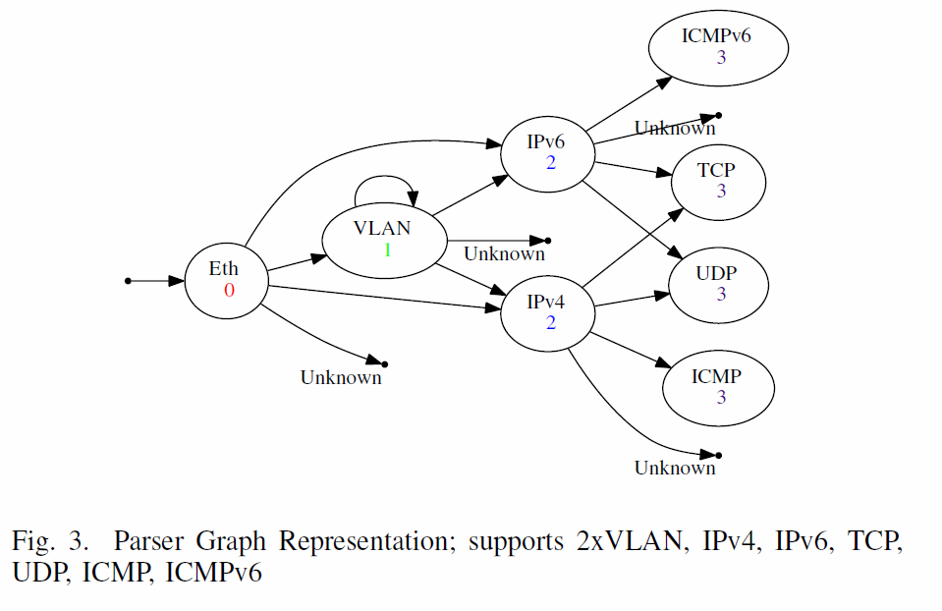

Slide 16
Generate Protocol Analyzer block
The Length Generator block is derived directly from P4 Header Description. It can be either a constant in case of constant length header, or a formula in case of variable length header.
The Next Protocol Decoder is also generated from the P4 Packet Parser description. Each transition from the parser state is described in the P4 switch statement by the tuple (value, next state).
Therefore we can implement Protocol Decoder by a multiplexer which selects the next protocol based on currently parsed values. The protocol headers that follow the currently parsed header are found in PGR.

Slide 17
Adder is a static block common to all Protocol Analyzers.
Data Extractor blocks are parameterizable units which can be used in all Protocol Analyzers without any change, only by setting the parameters to match the target protocol. Both Extract Length and Extract Offset parameters are directly derived from the P4 description.

Slide 18
Processing Chain
Generation of the processing chain uses PGR as an input. The key problem is to identify a place for insertion of each protocol analyzer in the processing chain.
Our task is to identify the longest paths to each node in a PGR. Length of the longest path from root to a node represents a position in the processing chain.
If we have several nodes on the same level, we connect protocol analyzers in series with arbitrary ordering.

Slide 19
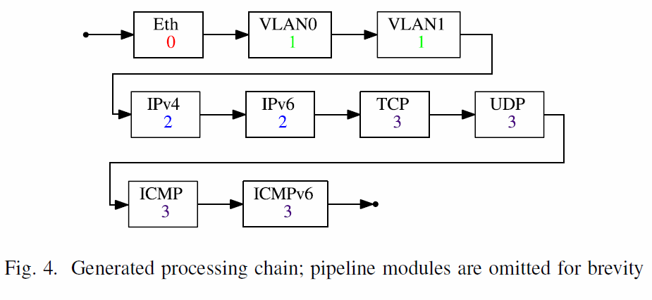

Slide 20
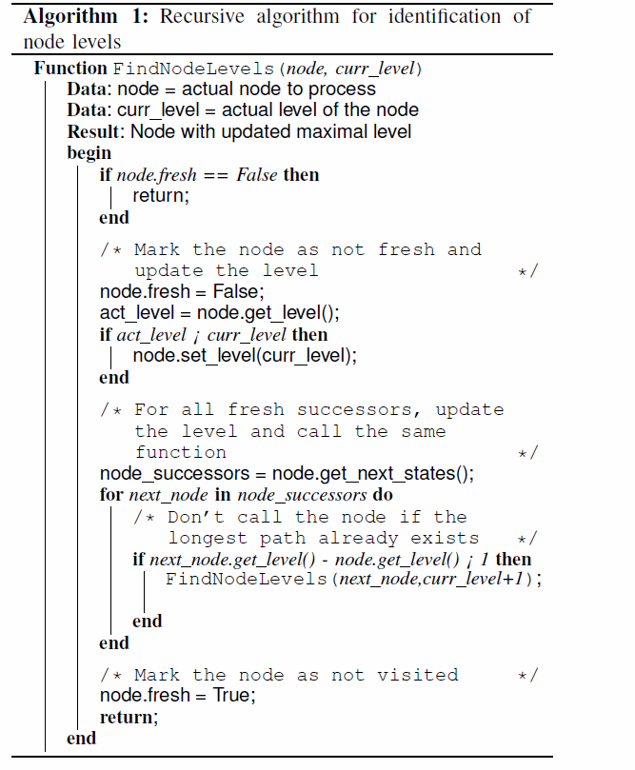
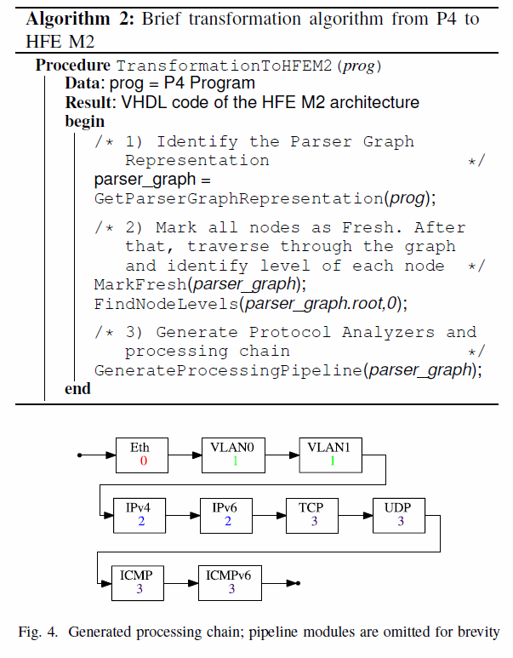

Slide 21
Optimizations
The first optimization is related to protocol analyzers’ GPPI interface. The key idea is to optimize width of the offset bus which is used for signalization of protocol header start (Input Offset and Output Offset signals).
The reason for this optimization is that protocol stack is being analyzed in a sequential manner within the packet. Therefore, the width of offset bus can increase in a sequential manner too – it is unnecessary to implement all logic (adders etc.) at full data width.
The bus width parameter is inferred from maximal protocol header lengths during translation. The bus width on each level is computed as a binary logarithm of the sum of all preceding protocol header lengths.

Slide 22
The second optimization is related to data extraction which is performed by multiplexers within Data Extractor blocks.
Generally, each Data Extractor is able to extract data from any byte position in the packet bus data word. The multiplexer is controlled by current data bus offset and the offset of the desired field within the header.
However, given the fact that the packet header may start only at certain positions on the data bus.
By making Data Extractors less general, we simplify the structure of each extraction multiplexer and save a significant amount of chip resources.

Slide 23
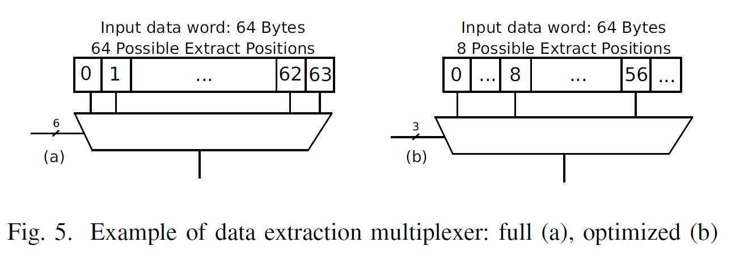

Slide 24
There is also a place for optimizations of P4 program which cannot be automatically generated. Instead, it is required to optimize the program during design time.
The basic idea is to merge protocol headers that are compatible in term of extracted protocol header fields.
As an example, we want to extract source and destination ports of TCP and UDP protocol. Therefore, we create a new fake protocol header which describes export of interesting fields.

Slide 25
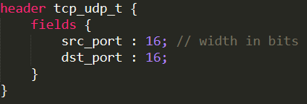
As an example, we want to extract source and destination ports of TCP and UDP protocol. Therefore, we create a new fake protocol header which describes export of interesting fields.
We don’t have to worry about incomplete protocol header specification because our replaced protocol headers are leaves of PGR, so that there is no further processing after this merged header.

Slide 26
RESULTS
We have tested properties of generated parsers with two different protocol stacks:
  full - Ethernet, 2×VLAN, 2×MPLS, IPv4/IPv6 (with 2× extension headers), TCP/UDP, ICMP/ICMPv6
  simple L2 - Ethernet, IPv4/IPv6 (with 2× extension headers), TCP/UDP, ICMP/ICMPv6
For each mentioned protocol stack, we compare the manually optimized HFE M2 parser and the generated parser with all optimizations enabled.

Slide 27
We provide results after synthesis for the Xilinx Virtex-7 XCVH580T FPGA using Xilinx Vivado 2015.1 design tool.
All designs were synthesized with different settings of the data width and the number of pipeline stages.
These solutions were searched for Pareto set which allows us to pick the best-fitting solution for an application.

Slide 28
No optimizations (O0) - no optimizations are used
Offset optimization (O1) - optimization of the offset width
Offset + multiplexer optimization (O2) - offset and multiplexer optimizations
Optimized P4 program (O3) - O0 version with effectively written P4 program (manual optimization)
All optimizations (O4) - all proposed optimizations are used

Slide 29
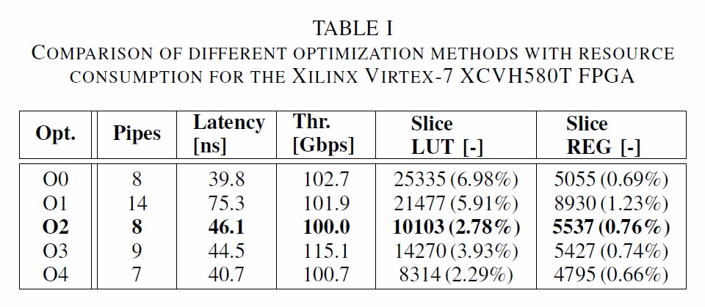

Slide 30
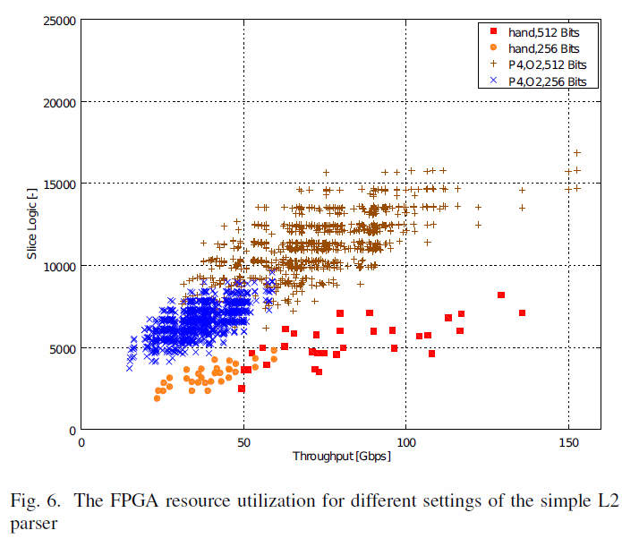
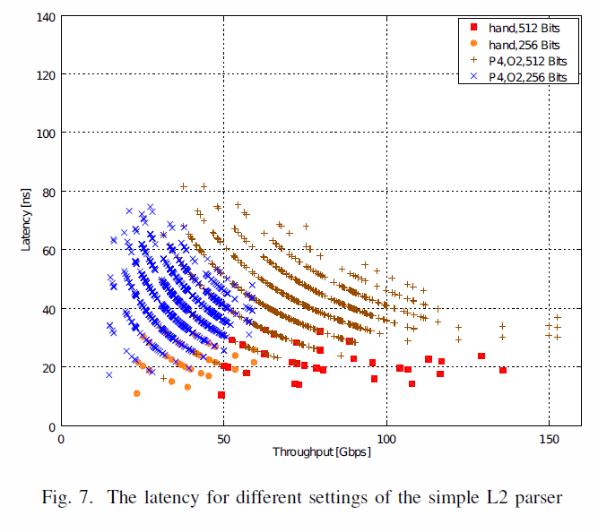

Slide 31
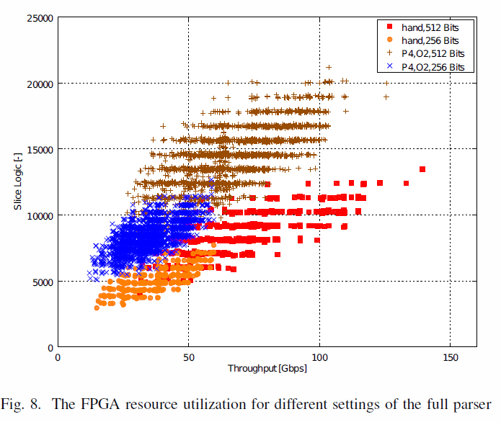
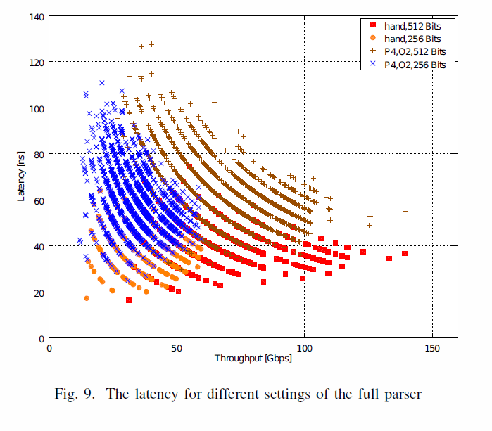

Slide 32
