Slide 1
LOP_RE: Range Encoding for Low Power Packet Classification
Author: Xin He , Jorgen Peddersen and Sri Parameswaran
Conference : IEEE 34th Conference on Local Computer Networks Presenter: Yen-Chun Tseng
Date: 2014/6/17
Department of Computer Science and Information Engineering
National Cheng Kung University, Taiwan R.O.C.
Notes:
1

Slide 2
Outline
Introduction
Proposed scheme
Performance Evaluation

Slide 3
Introduction
LOP : SRAM-based architecture for packet classiﬁcation which supporting packet-side encoding at wire speed.
LOP_RE : An extension of LOP scheme, called LOP RE which can support range encoding
Notes:
When packet matches expression, may do less work than Thompson's
algorithm

Slide 4
Outline
Introduction
Proposed scheme
Performance Evaluation

Slide 5
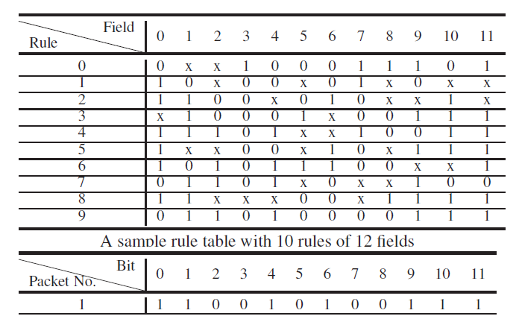
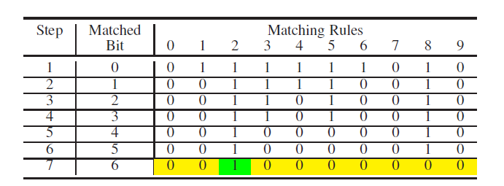
Proposed scheme (LOP)

Slide 6
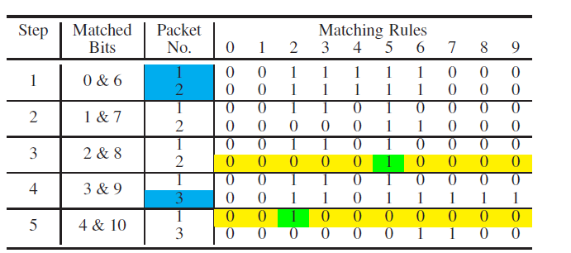
Proposed scheme (LOP)

Slide 7
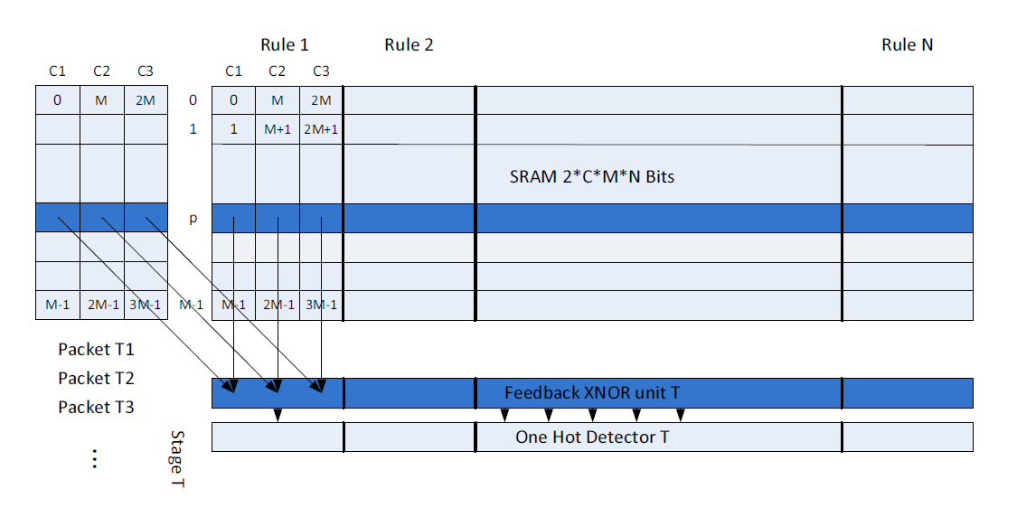
Proposed scheme (LOP)
0 -> 00 , 1 -> 01 , * -> 10 or 11

Slide 8
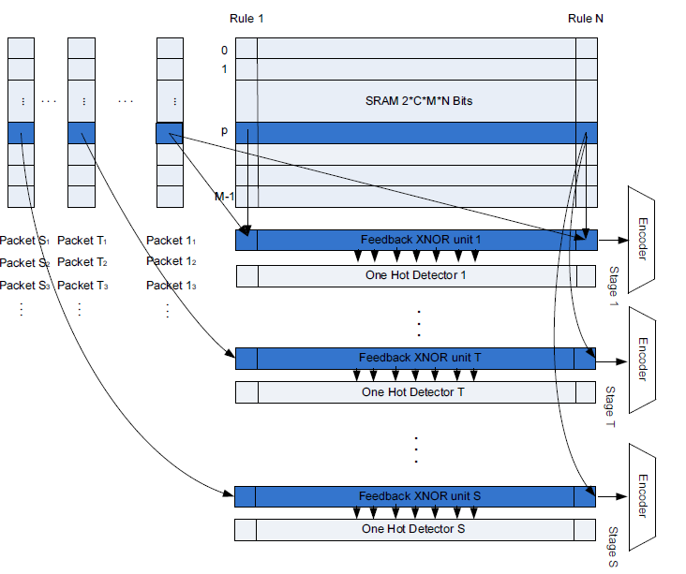
Proposed scheme (LOP)

Slide 9
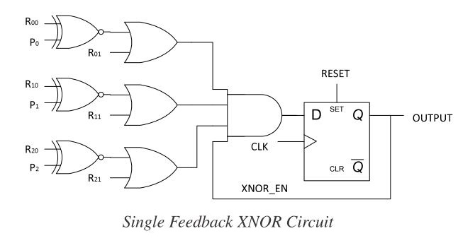
Proposed scheme (LOP)

Slide 10
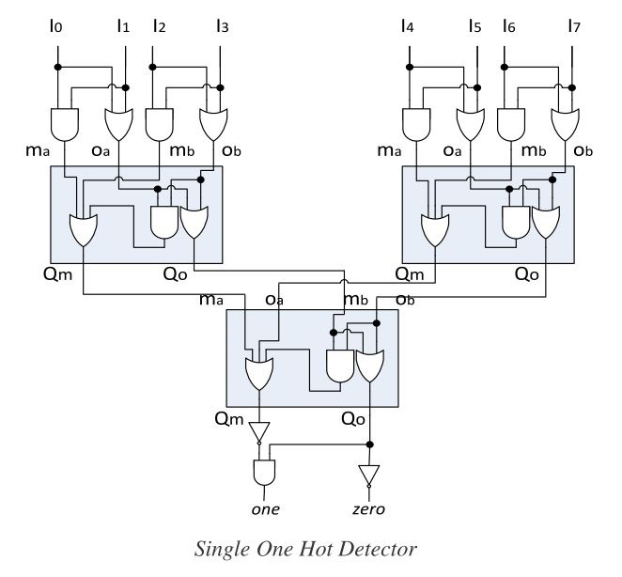
Proposed scheme (LOP)

Slide 11
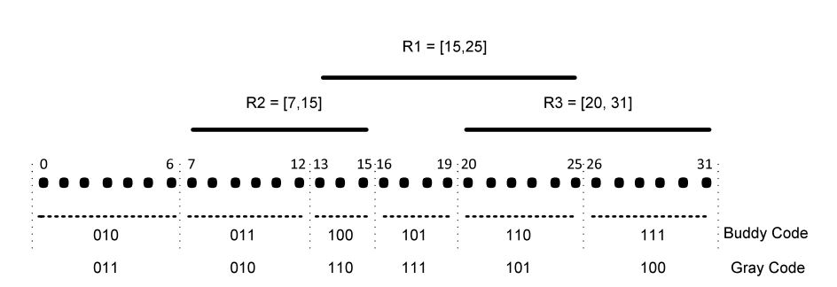
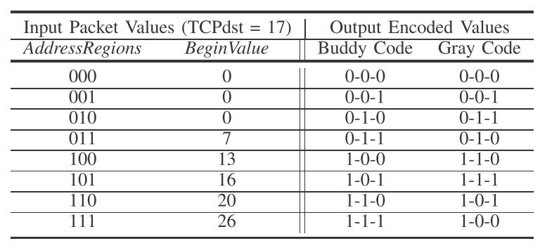
Proposed scheme (LOP_RE)

Slide 12
Proposed scheme (LOP_RE)

Slide 13
Proposed scheme (LOP_RE)

Slide 14
Proposed scheme (LOP_RE)

Slide 15
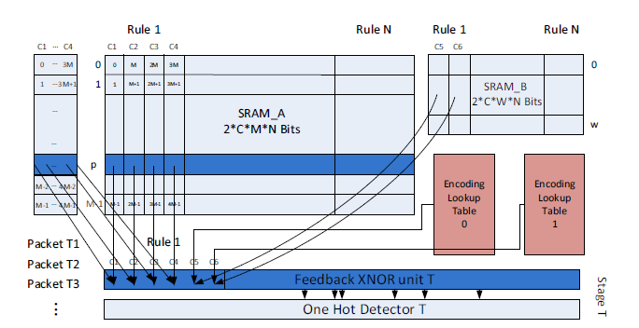
Proposed scheme (LOP_RE)

Slide 16
Outline
Introduction
Proposed scheme
Performance Evaluation

Slide 17
Performance Evaluation

Slide 18
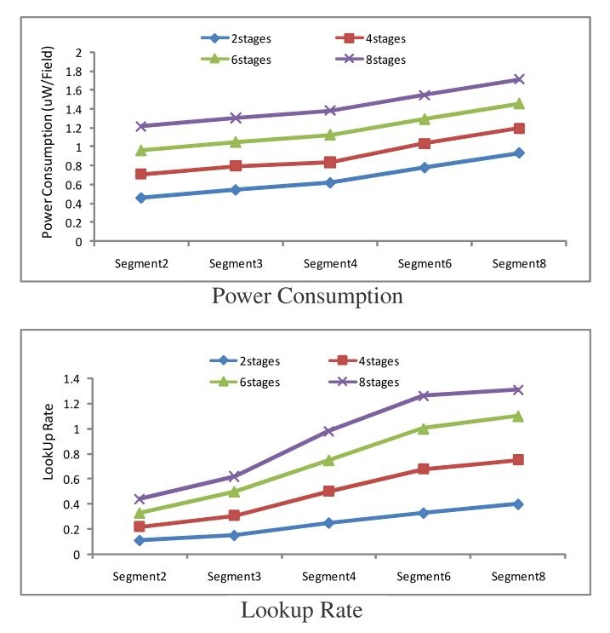
Performance Evaluation

Slide 19
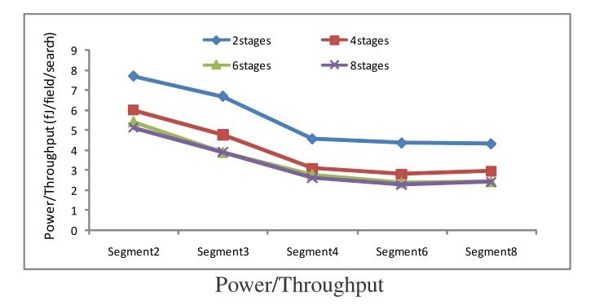
Performance Evaluation

Slide 20
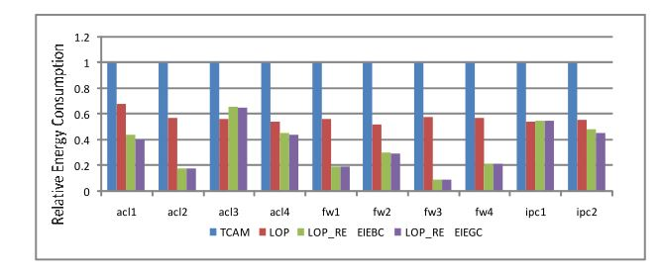
Performance Evaluation

