Slide 1
Compact DFA Structure for Multiple Regular Expressions Matching
Author: Wei Lin , Yi Tang, Bin Liu, Derek Pao and XiaoFei Wang
Conference: IEEE ICC, 2009
Presenter: Kuan-Chieh Feng
Date: 2017/02/15
Department of Computer Science and Information Engineering
National Cheng Kung University
Notes:
1

Slide 2
Outline
Introduction
CPDFA Architecture
Performance Evaluation

Slide 3
Introduction
New applications such as real-time deep packet inspection require high-speed regular expression matcher.
The number of regex is increasing to several thousands.
The Snort HTTP signature set will result in a DFA larger than 15GB.

Slide 4
Introduction
According to statistics of regexes in Snort and L7-filter rules, transitions from each state to its next states are not evenly distributed.
The summation of transitions from each state to its top three most popular next states takes about 90% of all the transitions.

Slide 5
Introduction
About 90% transitions will go to the top three most popular next states.
The remaining transitions are further optimized to store more compactly and access more efficiently. K parallel SRAMs with different size are used to hold a majority of the remaining transitions.
CPDFA uses pipelined architecture implemented in FPGA

Slide 6
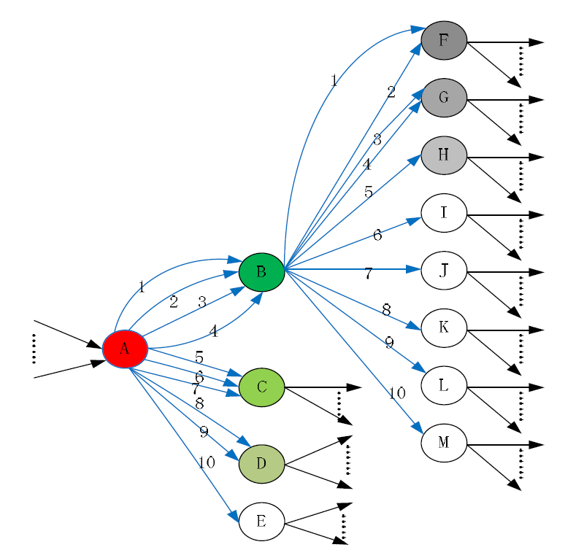
CPDFA Architecture
Original DFA
Notes:
假設將所有input character classes分為十種 並且根據其順序排列
數量前三多的state會先被歸類出來

Slide 7
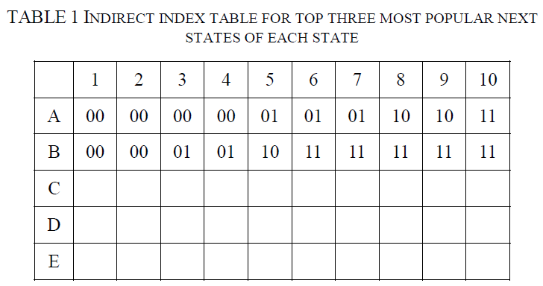
CPDFA Architecture
Indirect Table
Notes:
直列為state ID 橫列character classes
00 代表往最多的state transition
01 代表往第二多的 10代表往第三多的
00 代表不屬於前三多的transition

Slide 8
CPDFA Architecture
Because the three most significant next states for each state are different, a transition output table is used to record the three most significant next states for each state.
Let the number of states be M and the size of a state ID be L bits.
The transition output table can be organized as M rows by 3 x L bits wide

Slide 9
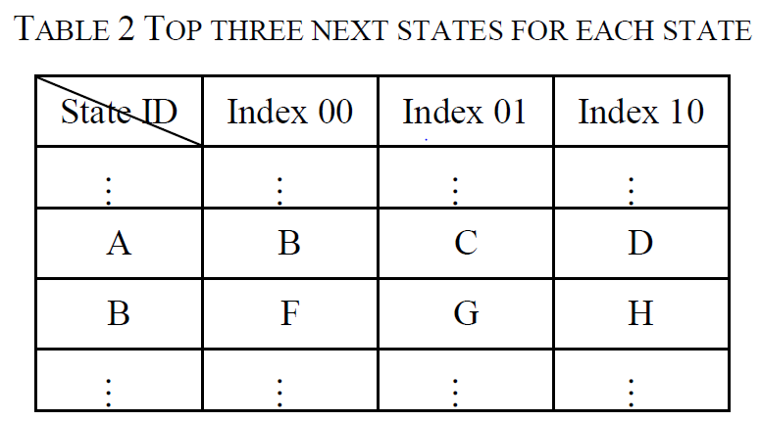
CPDFA Architecture
Transition Output Table
Notes:
查完indirect table後 接著要查transition output table

Slide 10
CPDFA Architecture
The offset obtained from indirect index table can be used to choose one of the three next state IDs of the selected row.
In this way, transitions from each state to its top three most popular next states can be stored and accessed efficiently.

Slide 11
CPDFA Architecture
The remaining transitions of each state are stored and accessed in different way according to whether the number of the remaining transitions of each state is more than K or not.

Slide 12
CPDFA Architecture
If the number of remaining transitions of a state is not more than K (K=4), the states will be arranged in descending order based on the number of remaining transitions of the state, and the transitions of the same state will be stored at the same address in different SRAMs from left to right.

Slide 13
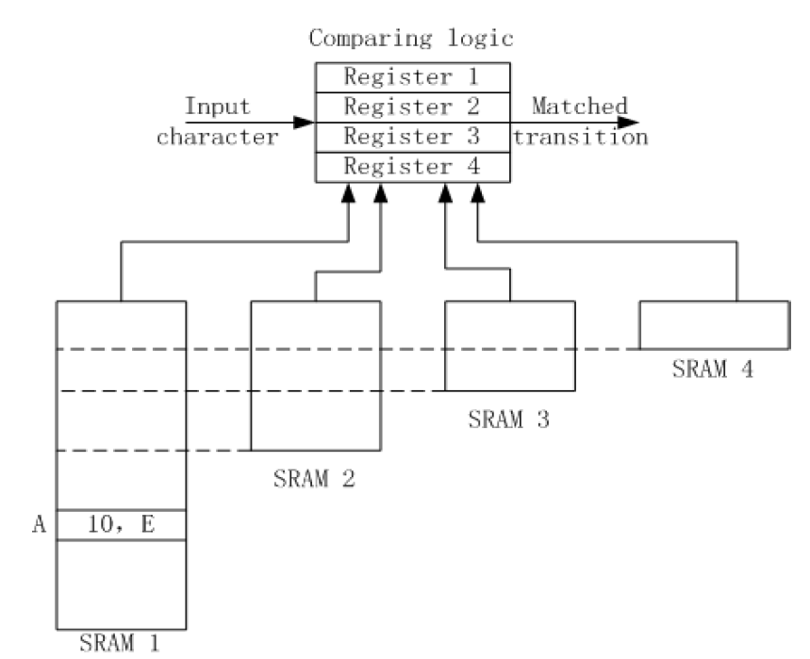
CPDFA Architecture
Notes:
The state ID is used as index to access the same address of multiple SRAMs
例如state A 只有一條outgoing transition 從A到E 則會被存在SRAM1
讀取石透過state ID來index SRAM的位置並且找出transition

Slide 14
CPDFA Architecture
If the number of remaining transitions for a state is more than K, the transitions will be stored in a direct transition table (DTT).
The row index is the state ID, and the column index is the input character class.
The table entry is the next state information.
Notes:
For example,
excluding the outgoing transitions from B to {F, G, H}, if the
number of outgoing transitions for state B is more than K
(K=4), one entry in DTT will be used to store these remaining
outgoing transitions for state B

Slide 15
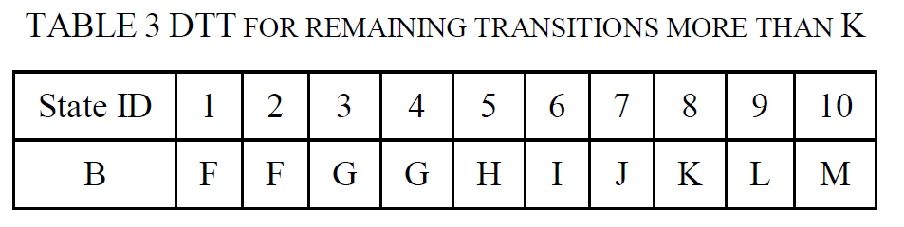
CPDFA Architecture
Direct Transition Table

Slide 16
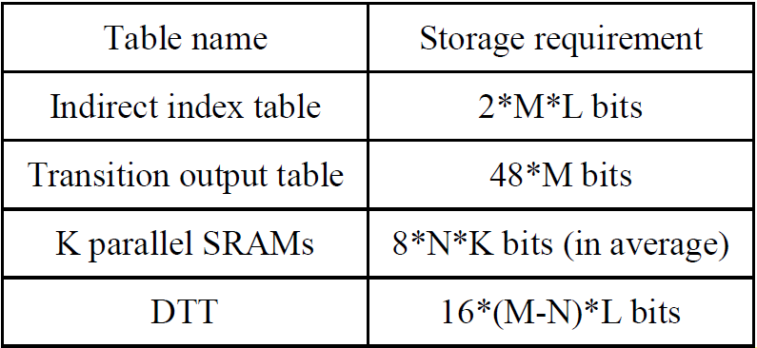
CPDFA Architecture
Storage Estimation
M : # of state in DFA
L : size of state ID
N : remaining transition less than K
X : number of character classes
Notes:
M : # of state in DFA
L : size of state ID
N : remaining transition less than K
X : number of character classes

Slide 17
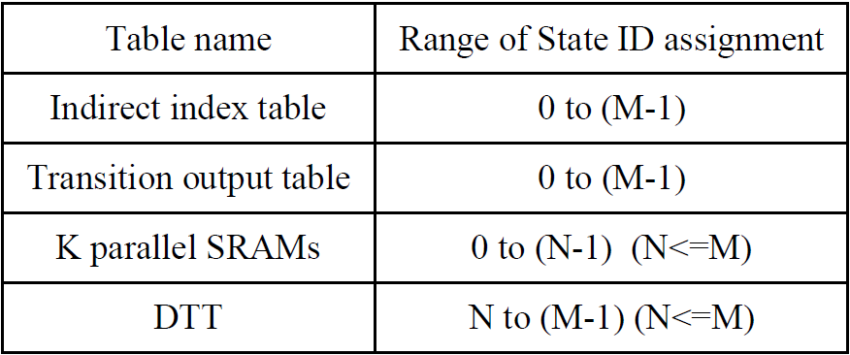
CPDFA Architecture
State ID Assignment

Slide 18
CPDFA Architecture
In order to share the above four tables with multiple DFAs, each DFA will be allocated a section of address space in each table and each DFA will record its starting address in each table.

Slide 19
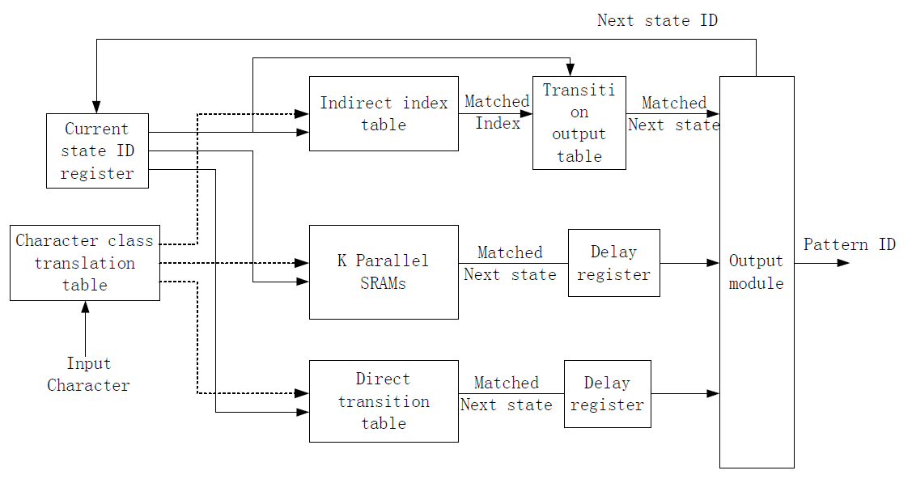
CPDFA Architecture
Notes:
Search會根據input character與current state來分辨
假如current state ID小於N的話 indirect table與K parallel sram會被同時讀取
假如大或小於N則會讀取indirect table與DTT
這個系統可以透過增加delay register來形成pipeline的架構，而throughput就是每讀取一個字元需要做幾次memory access

Slide 20
CPDFA Architecture
By using the indirect index to represent transitions to top three most popular next states, about 90% transitions can be represented more compactly and efficiently.
The remaining transitions of each state are stored in K parallel SRAMs or DTT, which further reduced the storage requirement to represent DFA transitions.

Slide 21
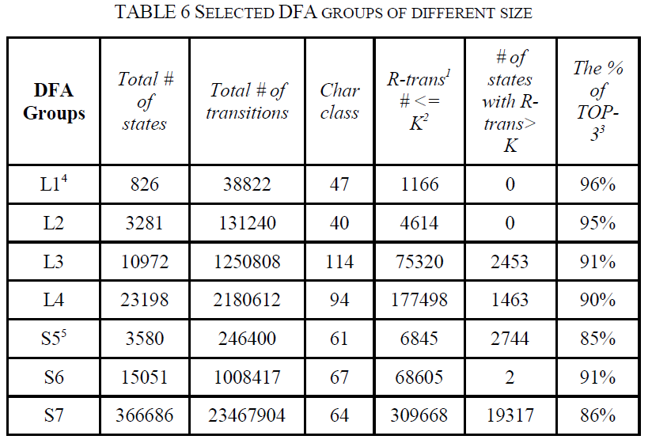
Performance Evaluation
Notes:
1 R-trans: remaining transitions except transitions to top 3 most popular
next states.
2 K: the default value is set to 10.
3 TOP-3: Transitions from each state to its top three most popular next
states
4 L: L7-filter rules group.
5 S: Snort rules group

Slide 22
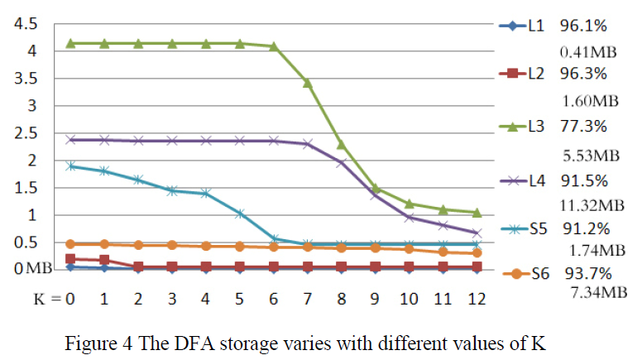
Performance Evaluation

Slide 23
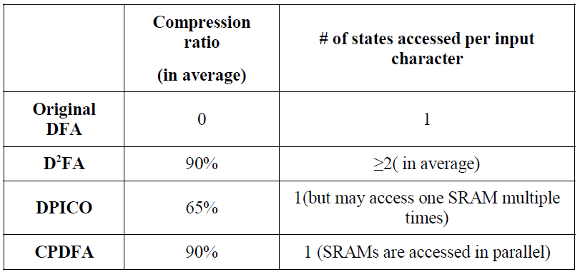
Performance Evaluation

