Slide 1
Reference Router on NetFPGA 1G
Course: | High-Performance Router Architecture and Design
Presenter: | Wei-Li, Wang
Date: | 107/03/27

Slide 2
INTRODUCTION
Open-source Hardware & Software
  NetFPGA is a platform that, combined with an open source code base (both software and hardware), enable rapid prototyping of networking devices.
Reference Designs
  The reference design for various application can be downloaded from [1], it contains a NIC or an IPv4 Router, even an OpenFlow switch.
For more details (datasheet specs, resources), please refer to [2].
It’s official website for NetFPGA family of boards.

Slide 3
INTRODUCTION
Reference Router Features [3]
  Forwards IPv4 packets of length 64-1500 bytes.
  Performs Longest Prefix Matching on destination address.
  Allows host receive packets by filter on destination address.
  Generates ICMP message for packets with TTL <= 1.
  Drops packets with bad IP checksum.

Slide 4
INTRODUCTION
Processing in Reference Router
1. Accept packet arriving on an incoming link.
2. Lookup packet destination address in the forwarding
table to identify outgoing port(s).
3. Manipulate IP header: e.g., decrement TTL, update
header checksum.
4. Buffer packet in the output queue.
5. Transmit packet onto outgoing link.

Slide 5
NetFPGA 1G BOARD
The NetFPGA 1G is a PCI card that includes the Logic Fabric, Memory, and Gigabit Ethernet Interfaces.
CPU
Memory
Host PC
PCI Bus
1G port
1G port
FPGA
Memory
NetFPGA 1G
1G port
1G port

Slide 6
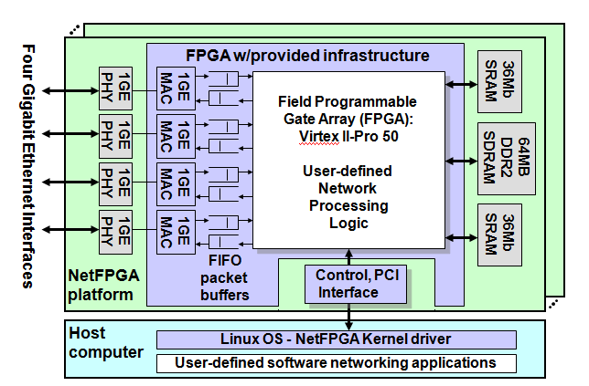
NetFPGA 1G BOARD

Slide 7
CORE DESIGN
Receive/Send packet from/to CPU
Both Rx Queue and Tx Queue
Both Rx Queue and Tx Queue
MAC Queues
CPU Queues
DMA Controller
MAC Queues
CPU Queues
MAC Queues
CPU Queues
MAC Queue
CPU Queue
User Data Path
Register
Group
MDIO Controller
SRAM
Controller
CPCI
Controller
Management with PHY
Communicate with SRAM
Allowing CPU write/read register

Slide 8
USER DATA PATH
Register
Master
data
data
ctrl
ctrl
Input Arbiter
Output Port
Lookup
Output Queues
wr
wr
rdy
rdy

Slide 9
DATA FORMAT
1 bytes | 2 bytes | 2 bytes | 2 bytes |  | 2 bytes
Ctrl Bus | Data Bus
0xFF | Destination port | Word length | Source port |  |  | Byte length
0xXX | Other module header (optional)
0x00 | Dst MAC address |  |  |  |  | Src MAC address
0x00 | Src MAC address |  | Ethertype |  |  | IP ver | Head len | ToS
0x00 | Total length | Identification | Flags | Fragment offset |  | Time to live |  | Protocol
0x00 | Header checksum | Src IP address |  |  |  | Dst IP address
0x00 | Dst IP address | ……
0x00 | …….
0x00 | ……
0x80 | Last byte
Prepended metadata
Ethernet Header
IP Header
Protocol Header &
Payload

Slide 10
OUTPUT PORT LOOKUP
pre_process_
control
ip_lpm
ip_arp
dest_ip_filter
op_lut_process_sm
ip_checksum_ttl
eth_parser
op_lut_hdr_parser
router_op_lut_regs
fallthrough_small_fifo

Slide 11
OUTPUT PORT LOOKUP
ip_lpm
ip_arp
next_hop_mac
output_port
in_data
next_hop_ip
lpm_output_port
arp_mac_vld
arp_lookup_hit
word_IP_SRC_DST
lpm_lookup_hit
word_IP_DST_LO
rd_arp_result

Slide 12
OUTPUT PORT LOOKUP
dst_ip_filter
dst_ip_hit
in_data
dst_ip_filter_vld
word_IP_SRC_DST
word_IP_DST_LO
rd_dst_ip_filter_result

Slide 13
OUTPUT PORT LOOKUP
ip_checksum_ttl
ip_checksum_vld
in_data
ip_checksum_is_good
in_wr
ip_hdr_has_options
ip_ttl_is_good
word_ETH_IP_VER
ip_new_ttl
word_IP_LEN_ID
ip_new_checksum
word_IP_SRC_DST
word_IP_DST_LO
rd_checksum

Slide 14
OUTPUT PORT LOOKUP
eth_parser
is_arp_pkt
in_data
is_ip_pkt
is_for_us
is_broadcast
word_ETH_IP_VER
mac_dst_port_num
word_IP_LEN_ID
eth_parser_info_vld
word_IP_SRC_DST
word_IP_DST_LO
eth_parser_rd_info

Slide 15
OUTPUT PORT LOOKUP
op_lut_hdr_parser
is_from_cpu
to_cpu_output_port
in_data
from_cpu_output_port
in_ctrl
input_port_num
rd_hdr_parser

Slide 16
FORWARDING DECISION
According to the information from the preprocess blocks, op_lut_process_sm determines the fate of the packet.
From CPU?
Send to MAC
Yes
Send to CPU
No
Non-IP
Dst MAC
Ether
type
Drop
Not for us
For us
IP

Slide 17
FORWARDING DECISION
IP
Drop
IP checksum correct?
No
Send to MAC
Yes
Send to CPU
Filter table hit?
Dec TTL
Update IP checksum
Set Dst MAC
Set Src MAC
Yes
No
Ver ==4?
No IP opts?
TTL > 1?
Routing table hit?
ARP table hit?
No
Yes
Drop
Broadcast

Slide 18
EXCEPTION PACKET PATH
Software
HOST
Driver
PCI
DMA
Registers
CPU
RxQ
CPU
TxQ
CPU
RxQ
CPU
TxQ
CPU
RxQ
CPU
TxQ
CPU
RxQ
CPU
TxQ
Register
Group
NetFPGA
User Data Path
MAC
TxQ
MAC
RxQ
MAC
TxQ
MAC
RxQ
MAC
TxQ
MAC
RxQ
MAC
TxQ
MAC
RxQ

Slide 19
REFERNCE
[1]https://github.com/NetFPGA/netfpga/wiki/Releases
[2]http://netfpga.org/
[3]http://www.cl.cam.ac.uk/research/srg/netos/projects/netfpga/workshop/cambridge-september-2011/2011_NetFPGA_Day_tutorial_Cambridge.pdf

