Slide 1
Glushkov NFA
Presenter: Yu Hao, Tseng
Date: 2014/8/25
Department of Computer Science and Information Engineering
National Cheng Kung University, Taiwan R.O.C.
Notes:
1

Slide 2
Outline
Introduction
Definitions
Constructing Procedure
  Glushkov
  NFA2DFA
Notes:
2

Slide 3
Introduction
We mark the positions of the characters of Σ in RE, counting only characters.
  (AT|GA)((AG|AAA)*) => (A1T2|G3A4)((A5G6|A7A8A9)*)
The Glushkov automaton is built first on the marked expression RE and it recognizes L(RE).
The set of positions is taken as a reference, becoming the set of states of the resulting automaton in addition to an initial state 0. So we build m+1 states labeled from 0 to m.

Slide 4

Definitions
We need four new definitions to explain in depth the algorithm.
  $First(\overline{RE})$
  $Last(\overline{RE})$
  $Follow(\overline{RE}, x)$
  ${Empty}_{RE}$

Slide 5
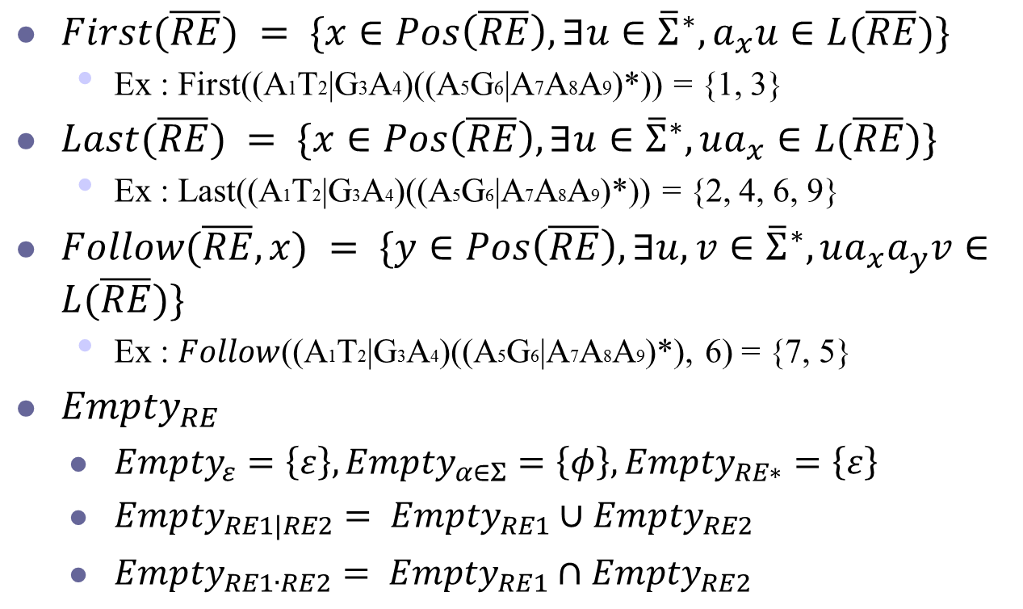
Definitions (Cont.)
$First(\overline{RE}) = \{x∈Pos\left(\overline{RE}\right), ∃u∈{\overline{Σ}}^{∗}, a_{x}u∈L(\overline{RE})\}$
  Ex : First((A1T2|G3A4)((A5G6|A7A8A9)*)) = {1, 3}
$Last(\overline{RE}) = \{x∈Pos\left(\overline{RE}\right), ∃u∈{\overline{Σ}}^{∗}, ua_{x}∈L(\overline{RE})\}$
  Ex : Last((A1T2|G3A4)((A5G6|A7A8A9)*)) = {2, 4, 6, 9}
$Follow(\overline{RE}, x) = \{y∈Pos\left(\overline{RE}\right), ∃u,v∈{\overline{Σ}}^{∗}, ua_{x}a_{y}v∈L(\overline{RE})\}$
  Ex : $Follow$((A1T2|G3A4)((A5G6|A7A8A9)*), 6) = {7, 5}
  ${Empty}_{RE}$
    ${Empty}_{ε}=\left\{ε\right\}, {Empty}_{α∈Σ}=\left\{φ\right\},{Empty}_{RE∗}=\left\{ε\right\}$
    ${Empty}_{RE1|RE2}= {Empty}_{RE1}∪{Empty}_{RE2}$
    ${Empty}_{RE1∙RE2}= {Empty}_{RE1}∩{Empty}_{RE2}$

Slide 6
Glushkov_variables (v, lpos) If v = ‘|’(vl, vr) OR v = ‘．’(vl, vr) Then lpos <= Glushkov_variables (vl, lpos) lpos <= Glushkov_variables (vr, lpos) Else If v = ‘*’(v*) Then lpos <= Glushkov_variables (v*, lpos) If v = ‘ε’ Then First(v) <= ∅, Last(v) <= ∅, Emptyv <= {ε} Else If v = ‘𝛼’, 𝛼 ∈ Σ Then lpos <= lpos + 1 First(v) <= {lpos}, Last(v) <= {lpos}, Emptyv <= ∅, Follow(lpos) <= ∅ Else If v = ‘|’(vl, vr) Then First(v) <= First(vl) ∪ First(vr) Last(v) <= Last (vl) ∪ Last (vr) Emptyv <= Emptyvl∪ Emptyvr Else If v = ‘．’(vl, vr) Then First(v) <= First(vl) ∪ (Emptyvl ．First(vr)) Last(v) <= (Emptyvr．Last (vl)) ∪ Last (vr) Emptyv <= Emptyvl ∩ Emptyvr For x ∈ Last (vl) Do Follow(x) <= Follow(x) ∪ First(vr) Else If v = ‘*’(v*) Then First(v) <= First(v*) Last(v) <= Last (v*) Emptyv <= {ε} For x ∈ Last (v*) Do Follow(x) <= Follow(x) ∪ First(v*) Return lpos

Slide 7
Constructing Procedure – Glushkov
Convert the parse tree into NFA using Glushkov algorithm。Ex : (AB|AD)(CE|CF)*。
‘‧’
C
1
B
2
C
5
E
6
‘|’
‘*’
C
E
A
B
C
C
‘‧’
‘‧’
.
0
‘|’
A
C
C
D
3
4
C
7
F
8
A
B
A
D
D
C
F
‘‧’
‘‧’
C
C
E
C
F
Notes:
Glushkov algorithm 主要的精神是把一個複雜的 regex 拆解成數個較小且較簡單的 regex 轉成 NFA
再將其數個小 NFA 依照連接運算符號組合起來
Glushkov NFA 因為轉換過程致使他最多 State 數為 single character 數量 + 1，這個 1 因為是要先 create an initial state

Slide 8
Constructing Procedure – NFA2DFA
Convert NFA into DFA using subset construction algorithm
[^AC]
C
B
C
E
A
1
2
5
6
B
[^AC]
A
C
A
C
C
A
B
0,2
C
A
2'
E
0, 6
5'
.
0
[BC]
A
[^A]
B
0
0,5,7
0'
0,1,3
4'
1'
A
C
C
D
0,4
0, 8
[CEF]
3'
C
F
6'
C
3
D
4
C
7
F
8
A
C
[^AC]
[BCD]
A
C
Symbol:
A
B
C
D
E
F
[^AC]
(a) NFA
{0, 1, 3}
(b) DFA
{0, 2}
{0, 4}
{0, 5, 7}
{0, 6}
{0, 8}
Subset:
{0}

Slide 9
Example : (AB|CD)E*
0
．
|
*
．
．
E
If v = ‘|’(vl, vr) OR v = ‘．’(vl, vr) Then lpos <= Glushkov_variables (vl, lpos) lpos <= Glushkov_variables (vr, lpos)
A
B
C
D

Slide 10
Example : (AB|CD)E* (Cont.)
0
．
|
*
．
．
E
If v = ‘|’(vl, vr) OR v = ‘．’(vl, vr) Then lpos <= Glushkov_variables (vl, lpos) lpos <= Glushkov_variables (vr, lpos)
A
B
C
D

Slide 11
Example : (AB|CD)E* (Cont.)
0
．
|
*
．
．
E
If v = ‘|’(vl, vr) OR v = ‘．’(vl, vr) Then lpos <= Glushkov_variables (vl, lpos) lpos <= Glushkov_variables (vr, lpos)
A
B
C
D

Slide 12
Example : (AB|CD)E* (Cont.)
1
First
Ch | State #
A | 1
0
Follow
Last
State # | 1
Empty | False
．
|
*
Else If v = ‘𝛼’, 𝛼 ∈ Σ Then lpos <= lpos + 1 First(v) <= {lpos}, Last(v) <= {lpos}, Emptyv <= ∅, Follow(lpos) <= ∅
．
．
E
A
B
C
D

Slide 13
Example : (AB|CD)E* (Cont.)
L_First
Ch | State #
A | 1
1
L_Follow
L_Last
State # | 1
L_Empty | False
0
．
|
*
．
．
E
If v = ‘|’(vl, vr) OR v = ‘．’(vl, vr) Then lpos <= Glushkov_variables (vl, lpos) lpos <= Glushkov_variables (vr, lpos)
A
B
C
D

Slide 14
Example : (AB|CD)E* (Cont.)
1
2
First
Ch | State #
B | 2
0
Follow
Last
State # | 2
Empty | False
．
|
*
Else If v = ‘𝛼’, 𝛼 ∈ Σ Then lpos <= lpos + 1 First(v) <= {lpos}, Last(v) <= {lpos}, Emptyv <= ∅, Follow(lpos) <= ∅
．
．
E
A
B
C
D

Slide 15
Example : (AB|CD)E* (Cont.)
L_First
Ch | State #
A | 1
1
2
L_Follow
L_Last
State # | 1
L_Empty | False
First
Ch | State #
A | 1
Follow
1 | B | 2
0
Last
State # | 2
Empty | False
R_First
Ch | State #
B | 2
R_Follow
R_Last
State # | 2
R_Empty | False
．
Else If v = ‘．’(vl, vr) Then First(v) <= First(vl) ∪ (Emptyvl ．First(vr)) Last(v) <= (Emptyvr．Last (vl)) ∪ Last (vr) Emptyv <= Emptyvl ∩ Emptyvr For x ∈ Last (vl) Do Follow(x) <= Follow(x) ∪ First(vr)
|
*
．
．
E
A
B
C
D

Slide 16
Example : (AB|CD)E* (Cont.)
1
2
L_First
Ch | State #
A | 1
L_Follow
1 | B | 2
L_Last
State # | 2
L_Empty | False
0
．
|
*
．
．
E
If v = ‘|’(vl, vr) OR v = ‘．’(vl, vr) Then lpos <= Glushkov_variables (vl, lpos) lpos <= Glushkov_variables (vr, lpos)
A
B
C
D

Slide 17
Example : (AB|CD)E* (Cont.)
1
2
0
．
|
*
．
．
E
If v = ‘|’(vl, vr) OR v = ‘．’(vl, vr) Then lpos <= Glushkov_variables (vl, lpos) lpos <= Glushkov_variables (vr, lpos)
A
B
C
D

Slide 18
Example : (AB|CD)E* (Cont.)
1
2
First
Ch | State #
C | 3
0
Follow
Last
State # | 3
Empty | False
3
．
|
*
Else If v = ‘𝛼’, 𝛼 ∈ Σ Then lpos <= lpos + 1 First(v) <= {lpos}, Last(v) <= {lpos}, Emptyv <= ∅, Follow(lpos) <= ∅
．
．
E
A
B
C
D

Slide 19
Example : (AB|CD)E* (Cont.)
L_First
Ch | State #
C | 3
1
2
L_Follow
L_Last
State # | 3
L_Empty | False
0
3
．
|
*
．
．
E
If v = ‘|’(vl, vr) OR v = ‘．’(vl, vr) Then lpos <= Glushkov_variables (vl, lpos) lpos <= Glushkov_variables (vr, lpos)
A
B
C
D

Slide 20
Example : (AB|CD)E* (Cont.)
1
2
First
Ch | State #
D | 4
0
Follow
Last
State # | 4
Empty | False
3
4
．
|
*
Else If v = ‘𝛼’, 𝛼 ∈ Σ Then lpos <= lpos + 1 First(v) <= {lpos}, Last(v) <= {lpos}, Emptyv <= ∅, Follow(lpos) <= ∅
．
．
E
A
B
C
D

Slide 21
Example : (AB|CD)E* (Cont.)
L_First
Ch | State #
C | 3
1
2
L_Follow
L_Last
State # | 3
L_Empty | False
First
Ch | State #
C | 3
Follow
3 | D | 4
0
Last
State # | 4
Empty | False
R_First
Ch | State #
D | 4
R_Follow
3
4
R_Last
State # | 4
R_Empty | False
．
Else If v = ‘．’(vl, vr) Then First(v) <= First(vl) ∪ (Emptyvl ．First(vr)) Last(v) <= (Emptyvr．Last (vl)) ∪ Last (vr) Emptyv <= Emptyvl ∩ Emptyvr For x ∈ Last (vl) Do Follow(x) <= Follow(x) ∪ First(vr)
|
*
．
．
E
A
B
C
D

Slide 22
Example : (AB|CD)E* (Cont.)
1
2
L_First
Ch | State #
A | 1
L_Follow
1 | B | 2
L_Last
State # | 2
L_Empty | False
First
Ch | State #
A | 1
C | 3
Follow
1 | B | 2
3 | D | 4
0
R_First
Ch | State #
C | 3
Last
State # | 2 | 4
Empty | False
3
4
R_Follow
3 | D | 4
R_Last
State # | 4
R_Empty | False
．
|
*
Else If v = ‘|’(vl, vr) Then First(v) <= First(vl) ∪ First(vr) Last(v) <= Last (vl) ∪ Last (vr) Emptyv <= Emptyvl∪ Emptyvr
．
．
E
A
B
C
D

Slide 23
Example : (AB|CD)E* (Cont.)
L_First
Ch | State #
A | 1
C | 3
L_Follow
1 | B | 2
3 | D | 4
1
2
L_Last
State # | 2 | 4
L_Empty | False
0
3
4
．
|
*
．
．
E
If v = ‘|’(vl, vr) OR v = ‘．’(vl, vr) Then lpos <= Glushkov_variables (vl, lpos) lpos <= Glushkov_variables (vr, lpos)
A
B
C
D

Slide 24
Example : (AB|CD)E* (Cont.)
1
2
0
3
4
．
|
*
．
．
E
Else If v = ‘*’(v*) Then lpos <= Glushkov_variables (v*, lpos)
A
B
C
D

Slide 25
Example : (AB|CD)E* (Cont.)
1
2
First
Ch | State #
E | 5
0
5
Follow
Last
State # | 5
Empty | False
3
4
．
|
*
Else If v = ‘𝛼’, 𝛼 ∈ Σ Then lpos <= lpos + 1 First(v) <= {lpos}, Last(v) <= {lpos}, Emptyv <= ∅, Follow(lpos) <= ∅
．
．
E
A
B
C
D

Slide 26
Example : (AB|CD)E* (Cont.)
1
2
First
Ch | State #
E | 5
First
Ch | State #
E | 5
0
5
Follow
Follow
5 | E | 5
Last
State # | 5
Empty | False
Last
State # | 5
Empty | True
3
4
．
Else If v = ‘*’(v*) Then First(v) <= First(v*) Last(v) <= Last (v*) Emptyv <= {ε} For x ∈ Last (v*) Do Follow(x) <= Follow(x) ∪ First(v*)
|
*
．
．
E
A
B
C
D

Slide 27
Example : (AB|CD)E* (Cont.)
L_First
Ch | State #
A | 1
C | 3
L_Follow
1 | B | 2
3 | D | 4
1
2
First
Ch | State #
A | 1
C | 2
Follow
1 | B | 2
2 | E | 5
3 | D | 4
4 | E | 5
5 | E | 5
L_Last
State # | 2 | 4
L_Empty | False
0
5
R_First
Ch | State #
E | 5
Last
State # | 2 | 4 | 5
R_Follow
5 | E | 5
Empty | False
3
4
R_Last
State # | 5
R_Empty | True
．
Else If v = ‘．’(vl, vr) Then First(v) <= First(vl) ∪ (Emptyvl ．First(vr)) Last(v) <= (Emptyvr．Last (vl)) ∪ Last (vr) Emptyv <= Emptyvl ∩ Emptyvr For x ∈ Last (vl) Do Follow(x) <= Follow(x) ∪ First(vr)
|
*
．
．
E
A
B
C
D

Slide 28
Example : (AB|CD)E* (Cont.)
First
Ch | State #
A | 1
C | 3
Follow
1 | B | 2
2 | E | 5
3 | D | 4
4 | E | 5
5 | E | 5
1
2
0
5
Last
State # | 2 | 4 | 5
3
4
Empty | False

Slide 29
Example : (AB|CD)E* (Cont.)
First
Ch | State #
A | 1
C | 3
Follow
1 | B | 2
2 | E | 5
3 | D | 4
4 | E | 5
5 | E | 5
1
2
A
0
5
Last
State # | 2 | 4 | 5
C
3
4
Empty | False

Slide 30
Example : (AB|CD)E* (Cont.)
First
Ch | State #
A | 1
C | 3
Follow
1 | B | 2
2 | E | 5
3 | D | 4
4 | E | 5
5 | E | 5
1
2
A
0
5
Last
State # | 2 | 4 | 5
C
3
4
Empty | False

Slide 31
Example : (AB|CD)E* (Cont.)
First
Ch | State #
A | 1
C | 3
Follow
1 | B | 2
2 | E | 5
3 | D | 4
4 | E | 5
5 | E | 5
1
B
2
A
E
0
5
E
Last
State # | 2 | 4 | 5
C
E
3
D
4
Empty | False

Slide 32
Example : (AB|CD)E* (Cont.)
First
Ch | State #
A | 1
C | 3
Follow
1 | B | 2
2 | E | 5
3 | D | 4
4 | E | 5
5 | E | 5
1
B
2
A
E
0
5
E
Last
State # | 2 | 4 | 5
C
E
3
D
4
Empty | False

